Slide 1



Smart Bin

Slide 2
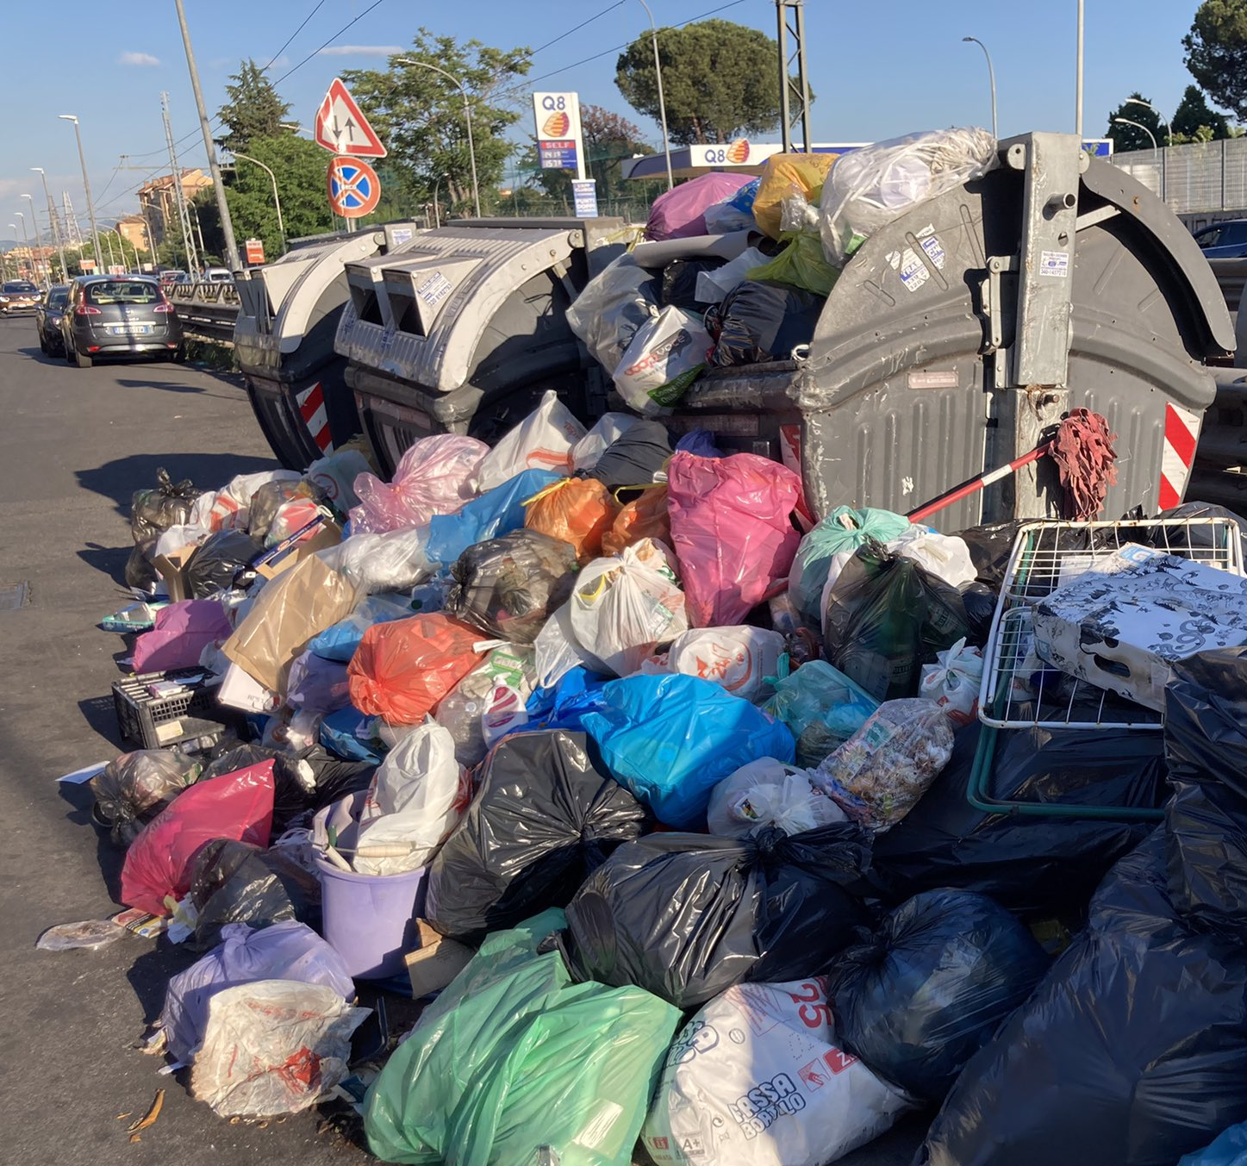
Waste management problem
PROBLEM
Waste management can create economic and environmental problems when it is not organised to ensure maximum efficiency.
Inefficiencies in waste collection
High costs
Pollution
Dustbins filled and/or overturned and/or set on fire

Slide 3

Our solutions
Solution 1
Solution 3
Detect the bin’s filling status
Manage access to bins via contactless card
Solution 2
Solution 4
Optimize collection logistics by proposing the optimal routing for vehicles
Alert operators in case of bin tampering with or fire

Slide 4
Smart Bin: Features
Solar powered
The bin is powered by the sun's energy, thanks to a small and efficient solar panel
Fill level detection
Only bins that are not full can be opened
CO2 level monitoring
An abnormal level of CO2, in case of fire, is immediately reported via Telegram
Automatic lid opening
Following user authorization and if the bin is not tampered with or full, the lid opens automatically
Tilt monitoring
Abnormal inclination of the bin is immediately reported via Telegram
Display
The display of the bin allows you to view the filling level, temperature, battery level and status. In addition, in case it is full, it displays the address of the neighbor with a bin of the same type in which the user can throw the garbage
Authentication through a contactless card
Each apartment is associated with bins and users can throw the garbage only in their apartment’s bins

Slide 5
Smart Bin: Services
Complete Map
Simple map that displays all monitored bins and their data.
Control of the status of the apartments’ bins via application
Service Map
Simple map displaying the full bins of the city to be emptied
Filling forecasts
The system allows to make predictions on the filling level of the bins to facilitate management and control
Map with the optimal path of emptying bins
Simple map to visualize the optimal path of emptying the bins
Fire and/or rollover warning

Slide 6



Environmental and social benefits in smart waste management
Precise control of the territory
Improve process efficiency
Better waste distribution
Reduction of CO2 emissions
Cleaner cities
Emergency response in case of overturning or fire
Immediacy and transparency of data
Reduction environmental pollution by identifying more convenient routes

Slide 7

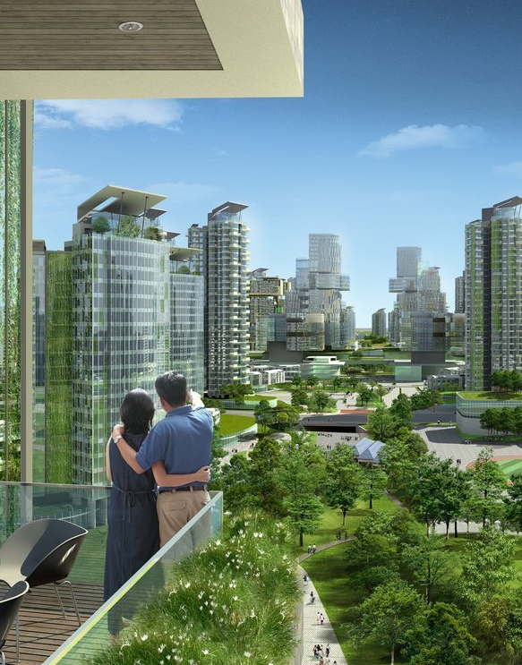
Thank you
Address
Email Id
Contact no
Address of the company
Company@email.com
123467894

